Slide 1

INTRUSION DETECTION SYSTEM
Team 08
Dhanush Kandagatla
Arjun Gandla
Siri Shreshta Reddy

Slide 2
— James Comey, Former Director of the FBI
“We’re in a world now where despite your best efforts, you must assume there will be breaches.”

Slide 3
$10.5 trillion
In 2023, the financial sector faces escalating cyber threats, with cybercrime damages estimated to hit $10.5 trillion by 2025.
Project Overview :
Our project focuses on developing a robust system to detect and alert against network intrusions, safeguarding sensitive financial data and assets.

Slide 4
Problem Statement
Recent trends show a significant increase in sophisticated cyber-attacks against financial sectors, leading to substantial financial and reputational damages.
Use Case
Our solution is designed to identify unusual network behaviors, both known and emerging threats, thereby ensuring enhanced security for financial institutions.

Slide 5
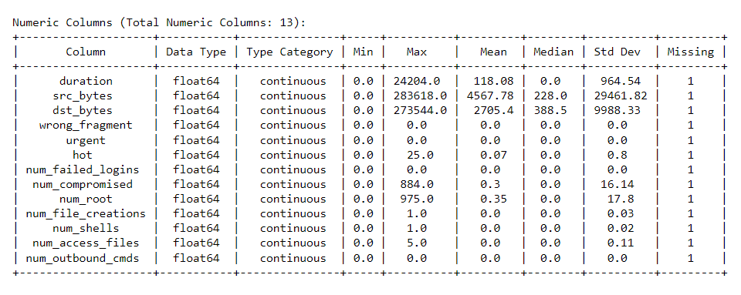
Data Set Dimensions – 3000 * 23

Slide 6
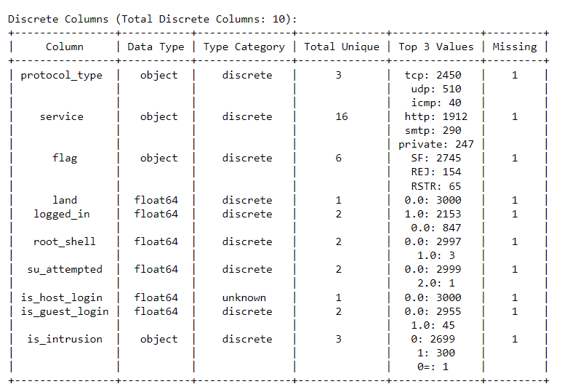

Slide 7
DATA CLEANING
Dropping Rows with Missing Values:
Removed all rows with any NaN values to ensure data completeness and integrity.
Preprocessing 'is_intrusion' Column:
Transformed the 'is_intrusion' column to numeric values (0 or 1) by removing '0=' from its entries.
Removing Zero Attributes and Correlation Analysis:
Dropped columns with constant zero values: 'land', 'wrong_fragment', 'urgent', 'num_failed_logins', 'num_outbound_cmds’.
Conducted a correlation analysis to understand the relationship of these removed attributes with other features in the dataset.

Slide 8
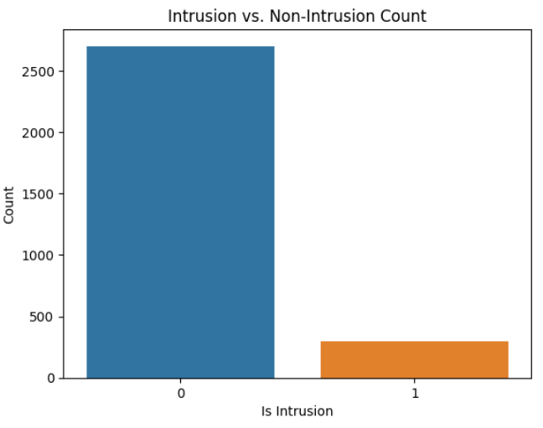
Intrusion Distribution
It is observed that less number of intrusions have occured. Thus it is a highly imbalanced dataset

Slide 9
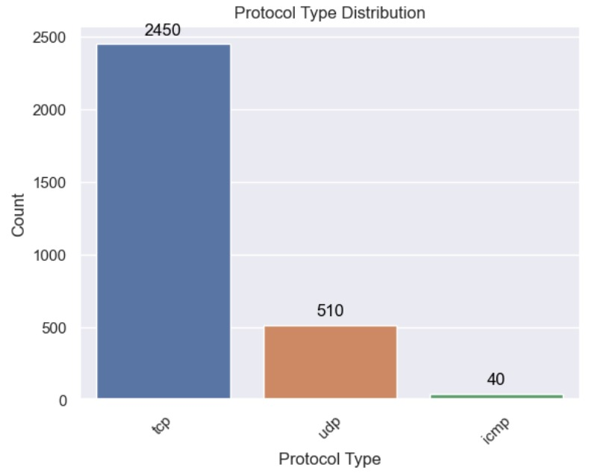
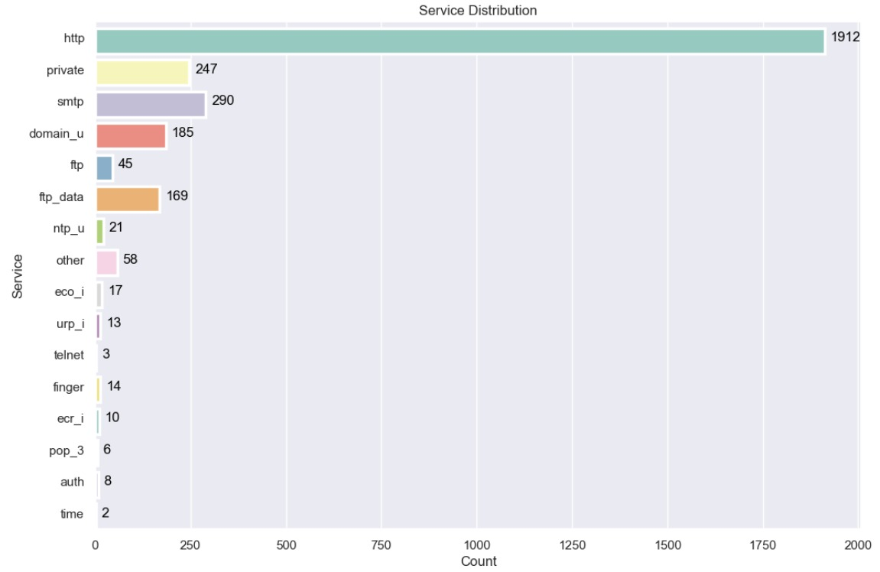
Protocol type and Service Distributions
TCP Protocol and HTTP Services have a prominent role in Data Transmission

Slide 10
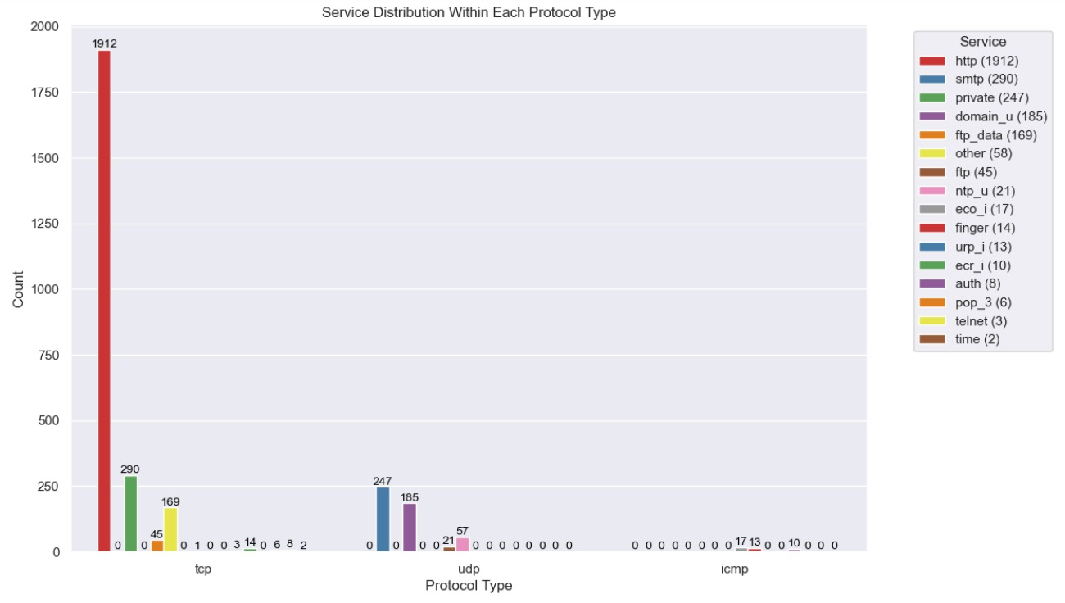
Protocol specific Service Distribution
Http, private services are the widely used within TCP Protocol

Slide 11
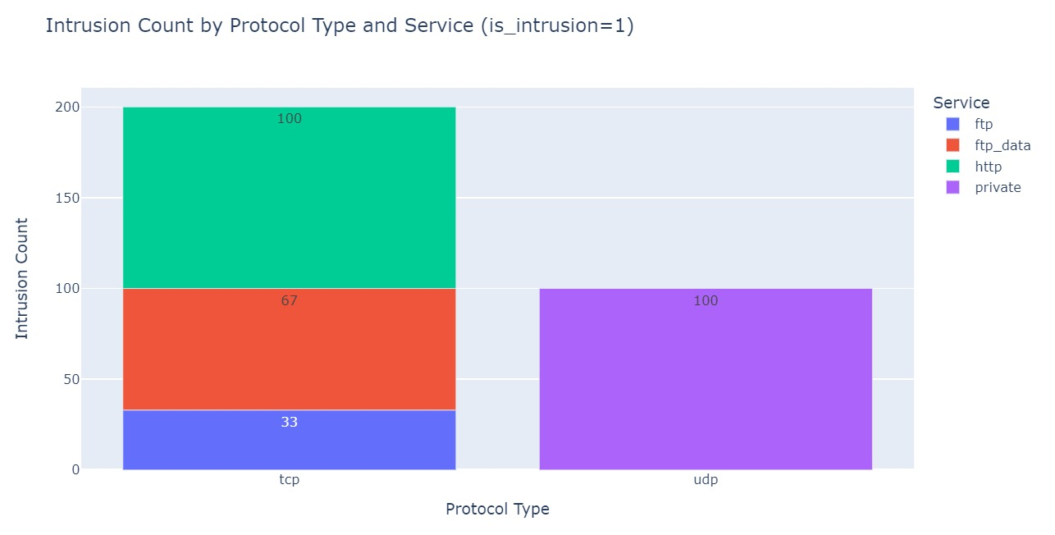
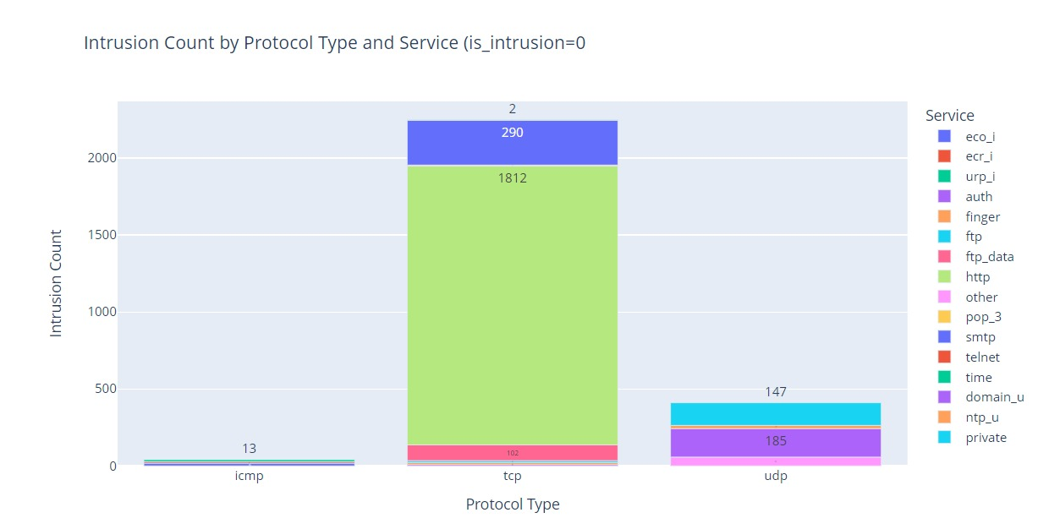
Intrusion Occurrence
In TCP protocol a greater number of Intrusions occurred in HTTP service
No Intrusions occurred in ICMP protocol making it a secure one
In UDP Prototype, a greater number of Intrusions occurred for Private service

Slide 12
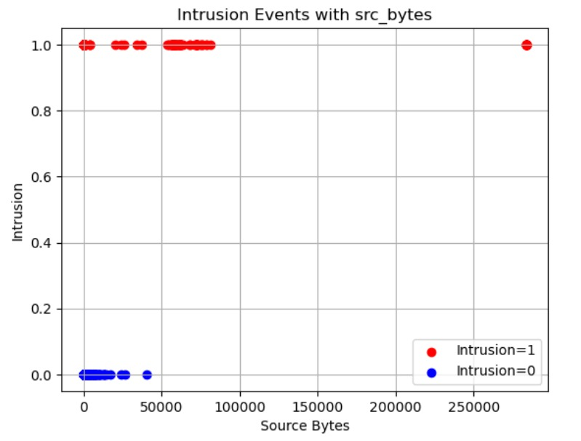
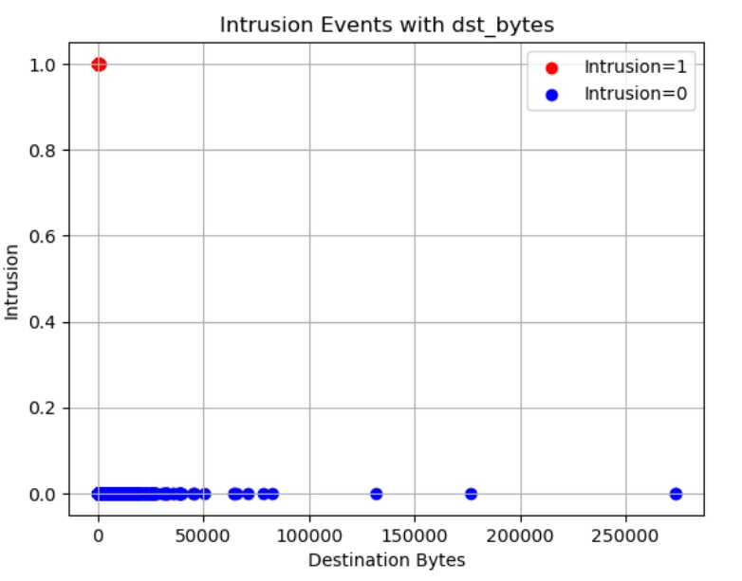
More number of Intrusions occurred while transmitting from Source Destination
Data Transfer Anomalies

Slide 13
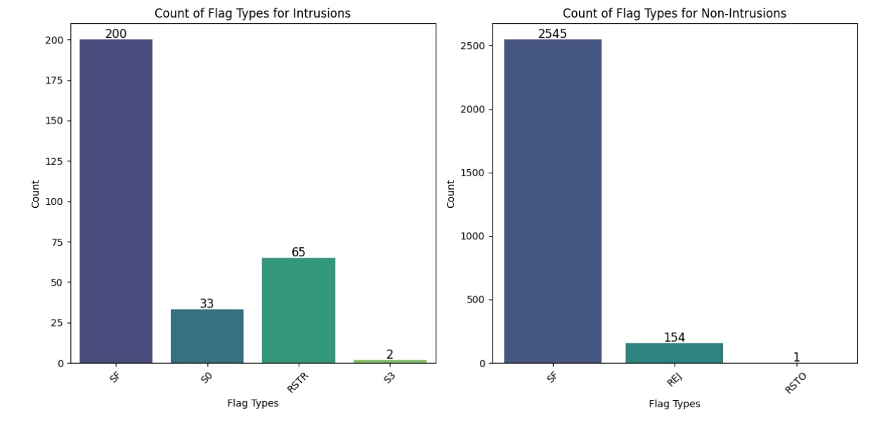
Flag-Based Intrusions:
S0: Initiates connection.
SF: Represents an established connection.
RSTR: Forces a connection reset.
More number of Intrusions occurred after establishing a connection and during resetting

Slide 14
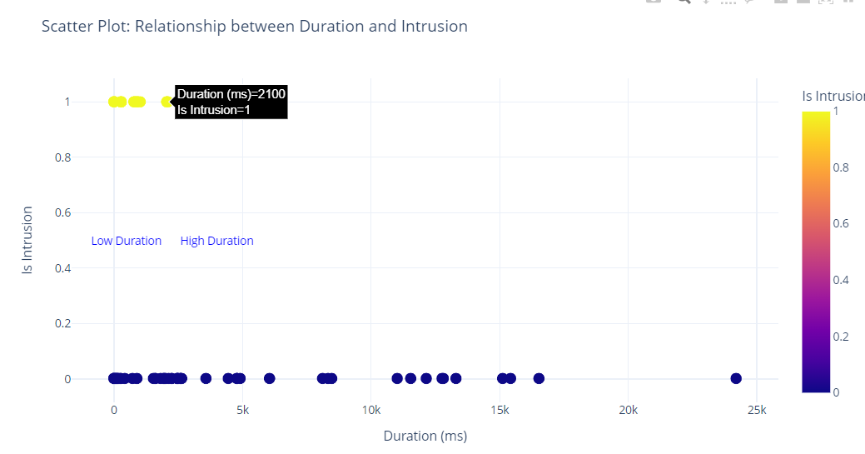
Unusual System Activity
Most of the Intrusions occurred at the beginning of the transmission

Slide 15
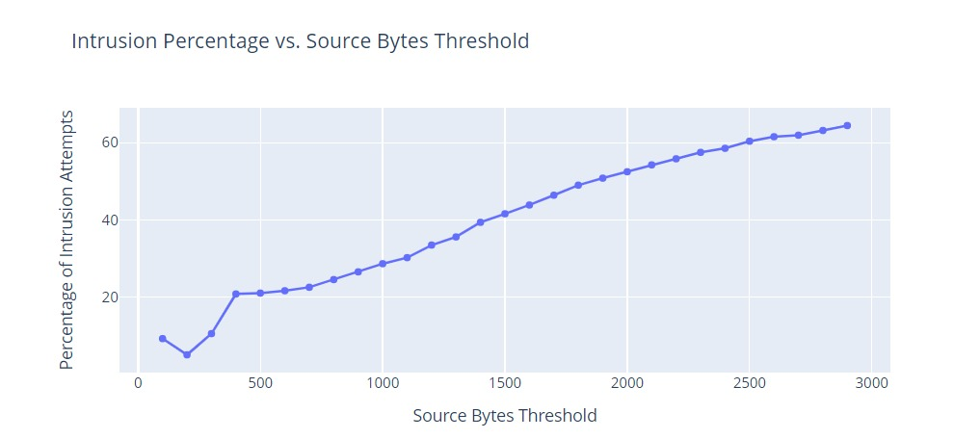
Intrusion Percentage vs Source Bytes Threshold
Percent of Intrusion attempts increases with increase in source bytes threshold.

Slide 16
XG Boost
Randomn Forest
Logistic Regression
We have used K-Fold Cross Validation to prevent overfitting
It effectively deals with imbalanced datasets often seen in intrusion detection.
It reveals key intrusion drivers by highlighting important features and is less prone to overfitting than single decision trees.
It's a fast and simple model for binary classification, ideal for quickly identifying the most predictive intrusion features.

Slide 17
Model Evaluation
PCA Analysis
Model Building
Feature Selection
Hyper-parameter Tuning

Slide 18
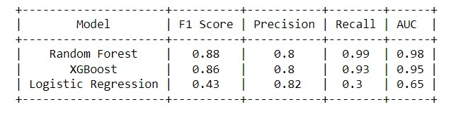
Evaluation Metrics
The Random Forest model is the most suitable for intrusion detection based on the provided metrics.
It achieves the highest F1 Score (0.8802), indicating a strong balance between precision and recall. With high precision (0.7953) and excellent recall (0.9867), it effectively identifies intrusions while minimizing false positives.

Slide 19
Further Analysis
We will Classify the data based on these Intrusions
TCP Exploit Intrusion
Service Vulnerability Breach
Data Exfiltration
DoS Flag Attack
We shall work on taking Real time Log Data

Slide 20
THANK YOU

